Slide 1

Lab #4

Slide 2
Lab 4 – General Instructions
Headings documentation requirements:
  Name
  Course
  Lab
  Date
Document command usage on first instance only

Slide 3
Lab 4 – General Instructions
Shellscripts MUST be completed ontime
Assigned Due Date:
  Run shellscripts for instructor
  Turn-in hardcopy of all shellscripts

Slide 4
Main Menu Modifications
Modify the Menu System created in Lab 2
  Menu Item selection number “3 (three)”.
  Menu Item Description “Launch Lab 4”
Add a Main Menu Heading line
  Centered two lines above the menu
  Identify the “Main Menu” and “PID #”

Slide 5
Main Menu Modifications
Trap the following signals by NAME and set “IGNORE” by doing NOTHING when the signal is received.
  Interrupt signal number 2
  Quit signal number 3
  Terminate signal number 15
  Kill signal number 9

Slide 6
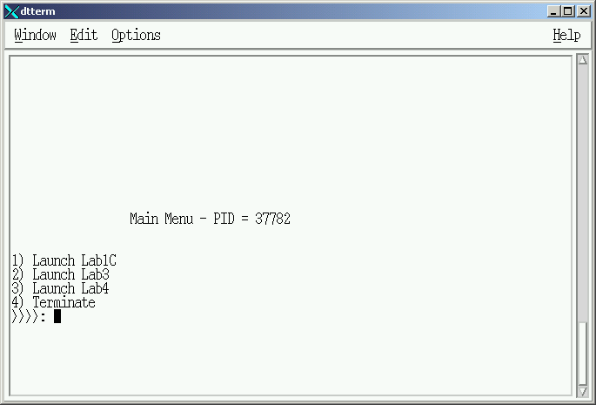
Main Menu Example

Slide 7
Launch Lab 4 – Sub Menu #1
Menu selection performs the following:
  Dynamically change the foreground and background screen colors.
    Only colors 0 – 7 will be selected
    Ensure foreground and background colors are different
  Displays Sub Menu #1 in the same screen position as the Main Menu

Slide 8
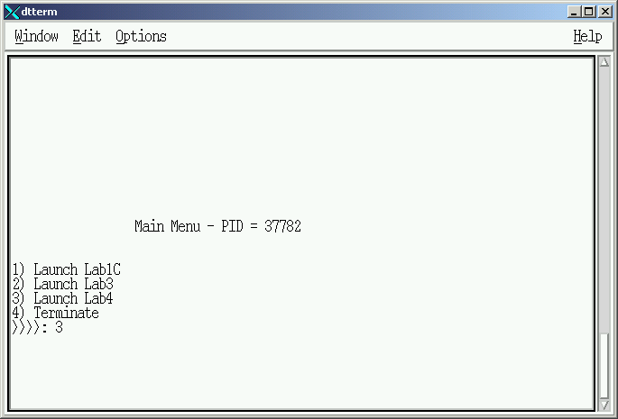
Sub Menu #1 - Access

Slide 9
Lab 4 – Sub Menu #1
Sub Menu contains 4 (four) Selection Items plus (default):
  Item 1 = “System Information”
  Item 2 = “ Future Lab “
  Item 3 = “ Future Lab “
  Item 4 = “Return”
  (Default)

Slide 10
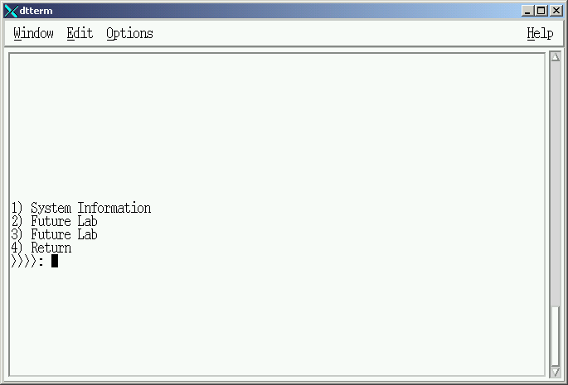
Sub Menu #1

Slide 11
Lab 4 – Sub Menu #1
Selection of “Items 2 & 3”
  Item Labels = “Future Labs”
  Action:
    Clear the screen
    Redisplay Sub Menu #1.

Slide 12
Lab 4 – Sub Menu #1
Selection of “Item 4”
  Item Labels = “Return”
  Action:
    Clear the screen
    Redisplay Main Menu

Slide 13
Lab 4 – Sub Menu #1
Selection of “Item 1”
  Item Labels = “System Information”
  Action:
    Clear the screen
    Display Sub Menu #2

Slide 14
Lab 4 – Sub Menu #1
Selection of “Item (default)”
  Action:
    Set foreground and background to fixed colors
    Clear the screen
    Flash an ERROR MESSAGE in the middle of the screen for 5 seconds
    Return to sub menu #1

Slide 15
Launch Lab 4 – Sub Menu #2
Menu selection performs the following:
  Dynamically change the foreground and background screen colors.
    Only colors 0 – 7 will be selected
    Ensure foreground and background colors are different
  Displays Sub Menu #2 in the same screen position as the Main Menu and Sub Menu #1

Slide 16
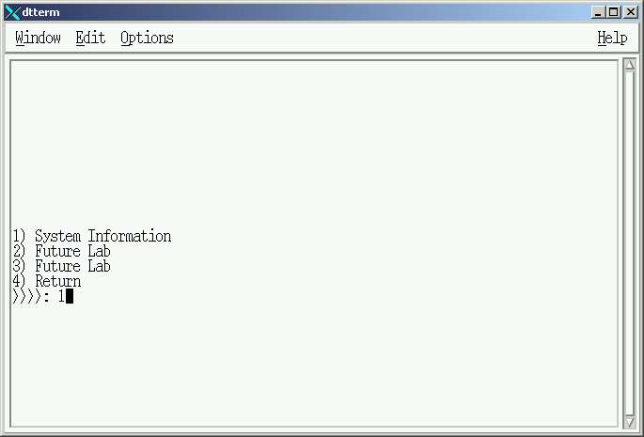
Sub Menu #2 - Access

Slide 17
Lab 4 – Sub Menu #2
Sub Menu contains 4 (four) Selection Items plue default:
  Item 1 = “Memory”
  Item 2 = “Paging Information“
  Item 3 = “Disk Information“
  Item 4 = “Return”
  Item = (Default)

Slide 18
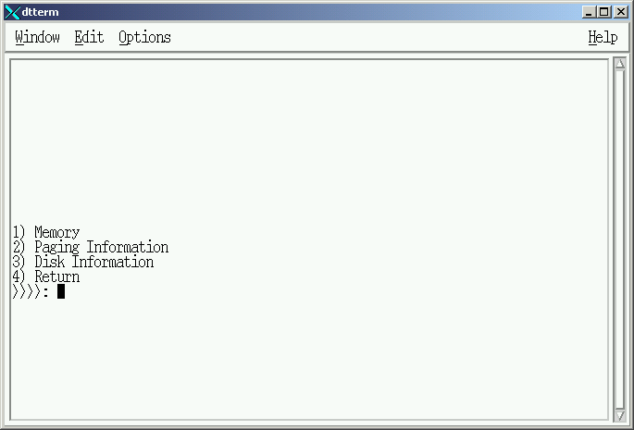
Sub Menu #2

Slide 19
Lab 4 – Sub Menu #2
Selection of “Item 1”
  Item Label = “Memory”
  Action:
    Use “memory_template” on next foil making indicated additions.
    Return to sub-menu #2

Slide 20
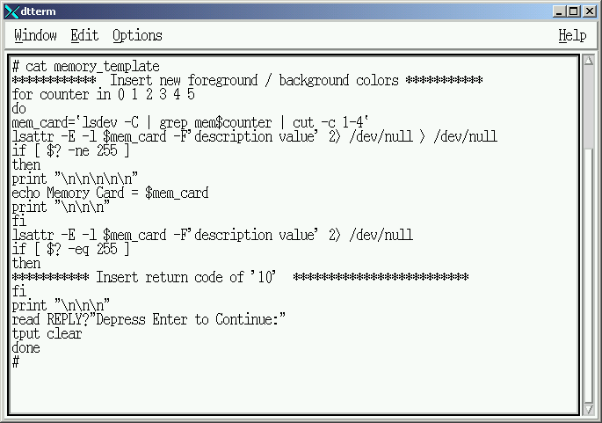
Memory Information Template
Insert return code of ’10’

Slide 21
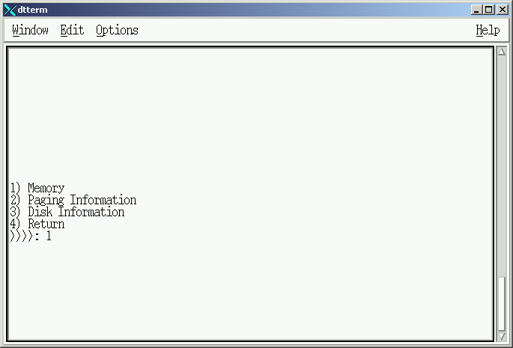
Memory Information

Slide 22
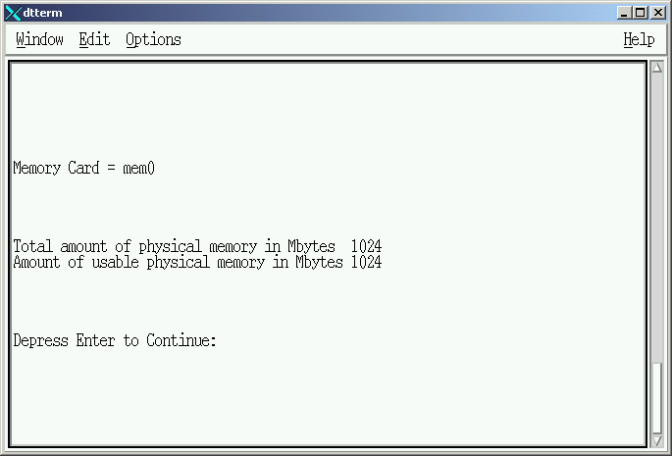
Memory Information

Slide 23
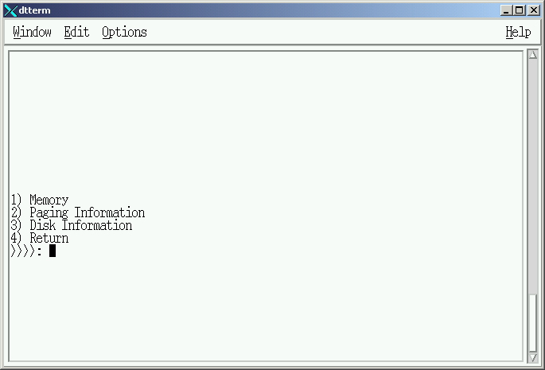
Memory Information

Slide 24
Lab 4 – Sub Menu #2
Selection of “Item 2”
  Item Label = “Paging Information”
  Action:
    Use “paging_template” on next foil making indicated additions.
    Return to sub-menu #2

Slide 25
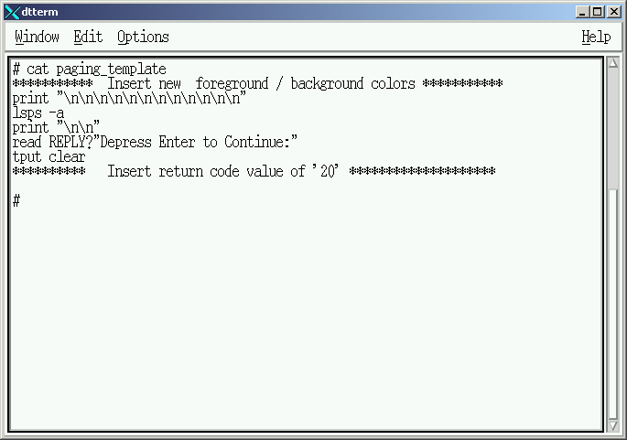
Paging Information Template

Slide 26
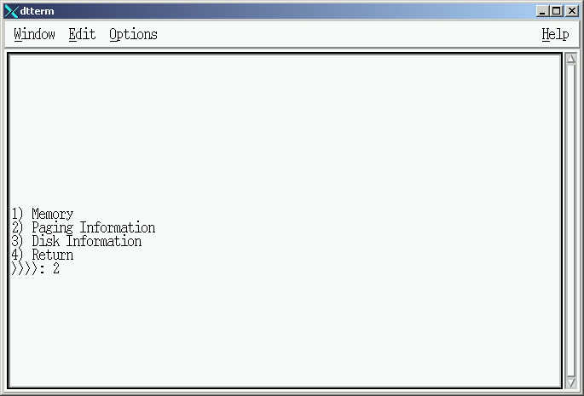
Paging Information

Slide 27
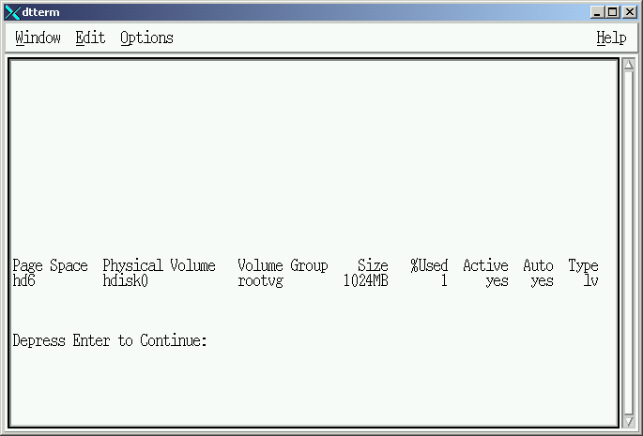
Paging Information

Slide 28
Lab 4 – Sub Menu #2
Selection of “Item 3”
  Item Label = “Disk Information”
  Action:
    Use “disk_template” on next foil making indicated additions.
    Return to sub-menu #2

Slide 29
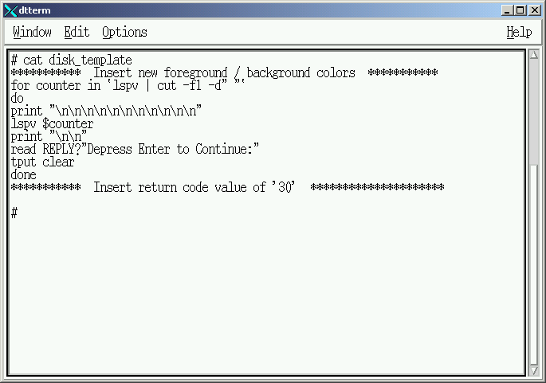
Disk Information Template

Slide 30
Sub Menu #2 – Return Codes
Perform AFTER menu items 1,2 & 3 complete and return to sub menu #2.
Action:
    Set foreground and background to fixed colors
    Clear the screen
    Flash a MESSAGE in the middle of the screen for 5 seconds
    Message selection based on the Return Code sent by the termination of items 1, 2 or 3.
      Example: Menu Selection #1 (Memory Information) terminates with a return code = 10. The parent process (sub menu #2) will take that return code and display “Memory Information Report Completed”.
    Return to sub menu #2

Slide 31
Lab #4

